Slide 1

Data Science Sharing Digital Supply Chain Transformation Team Liu Lu (luliu@sg.ibm.com) May 8th, 2025

Slide 2

Agenda
Data Analysis Techniques
How to Choose the Right Technique
Real-World Examples
GenAI and Data Analysis
Q&A

Slide 3
Data Analysis Techniques
Data Visualization
Descriptive Analysis
Predictive Analysis
Prescriptive Analysis
Diagnostic Analysis
Scripted AI
Gen AI
Extract, Transform, Load Data

Slide 4
Descriptive Analysis
Answers “What happened?”.
Describe the main features of a dataset, summarize historical data, focuses on aggregation, visualization, and reporting.
What is it?
When to Use
Common Techniques
Data Requirements
We need to summarize past performance (e.g., monthly sales, inventory level)
We’re performing an initial exploration of data before deeper analytics
We want to communicate insights to stakeholders
We need to detect data quality issues or data distributions
Summary statistics (mean, median, counts)
Cross-tabulations and pivot tables
Visualizations:
Trend lines and time series plots
Histograms, bar charts, heatmaps
Clean historical data (structured or semi-structured)
Accurate timestamp or categorical grouping variables
Technique | Description | Example
Mean, Median, Mode | Central tendency measures | Average sales per month
Standard Deviation, Variance | Measure of spread | Variation in product inventory
Minimum, Maximum, Range | Data boundaries | Range of product lead time
Frequency Counts | Occurrence of values | Number of MTMs per brand
Cross-tabulations / Pivot tables | Compare categories | Sales by region and product
Data Visualizations | Charts and plots | Bar charts, histograms, box plots, line charts
Percentiles and Quartiles | Distribution summary | Top 25% of customers
Trend Analysis | Historical progression | Revenue trend over years
Requirement | Details
Clean and structured data | Missing values, duplicates, and inconsistencies should be handled
Proper data types | Numerical, categorical, date/time fields appropriately defined
Historical data | Data collected over time or across groups
Sufficient sample size | Large enough to provide meaningful summary statistics
Defined business questions | Knowing what to look for guides the selection of summary metrics

Slide 5
Descriptive Analysis Examples
Category | Techniques | Purpose | Example Use Case
Inventory Management | Summary statistics, stock level reports | Monitor inventory positions and trends | Summarize current stock levels by warehouse and SKU
Order Fulfillment | Fill rate calculation, delivery rate analysis | Report service levels and fulfillment success | Track on-time delivery percentage per customer
Supplier Performance | KPI dashboards, average lead time tracking | Monitor reliability and responsiveness | Summarize average lead time per supplier last 12 months
Procurement Spend | Spend classification, top-N supplier spend ranking | Understand where and how money is being spent | List top 10 suppliers by total spend
Logistics Operations | Transportation cost breakdown, delivery route stats | Track shipping costs, routes, and volumes | Report weekly transport costs per carrier and region
Warehouse Operations | Inbound/outbound volume reporting, utilization rates | Measure productivity and throughput | Summarize inbound shipments processed per day
Demand Trends | Time series visualization, moving averages | Identify historical sales or order patterns | Plot monthly demand trend by product family
Returns Tracking | Returns volume report, defect rate chart | Monitor reverse logistics and quality issues | Display return rates per product category
Forecast Accuracy | MAPE, forecast vs. actual comparison | Measure accuracy of demand planning | Show weekly forecast error rates
Sourcing Breakdown | Supplier count per region, category spend share | Visualize sourcing diversification | Report percent of parts sourced from each region

Slide 6
Diagnostic Analysis
What is it?
Explains why something happened through pattern recognition, correlation, or segmentation.
When to Use
Common Techniques
Data Requirements
A KPI shows an unexpected change (e.g., drop in revenue, spike in defects)
Descriptive analysis reveals a trend or anomaly that needs further explanation
We’re performing a root cause analysis of business or operational issues
We want to segment data to compare different groups or periods (narrow down investigation scope)
Correlation & covariance analysis
Hypothesis testing (t-test, ANOVA)
Clustering (k-means, DBSCAN)
Association rule mining (market basket analysis)
A/B testing
Time- or event-based historical data
Clear variable definitions and categorizations
Technique | Description | Example
Drill-down / Slice-and-dice | Break down aggregates into subgroups | Sales dropped — is it from a specific region or product?
Comparative Analysis | Compare performance between segments | Compare customer churn before and after a new policy
Correlation Analysis | Check for relationships between variables | Is suppliers’ average lead time correlated with % of on-time deliveries?
Trend Break Analysis | Detect shifts or disruptions in patterns | Identify sudden drops in shipment quantity
Root Cause Analysis (RCA) | Trace back to the root factor(s) | Why did manufacturing defects spike?
Pareto Analysis (80/20 Rule) | Identify vital few contributors | Which 20% of root causes cause 80% of failures?
Hypothesis Testing | Use statistical tests to confirm assumptions | Is the drop in NPS score significant?
Anomaly Detection | Identify outliers or unusual patterns | Sudden spike in customer complaints flagged as anomaly
Requirement | Details
Detailed and granular data | Ability to break down into subcategories (e.g., by region, market segment)
Historical data | Time-series data helps identify when changes happened
Data context | Metadata or external variables (geopolitics, seasonality) for understanding influences
Categorical and numerical features | Needed for segmentation and correlation
Clean and consistent format | Enables accurate comparisons and analysis
Baseline or benchmark values | For evaluating deviations or impacts

Slide 7
Diagnostic Analysis Examples
Category | Techniques | Purpose | Example Use Case
Shipment Delays | Root cause analysis, lead time decomposition | Understand why deliveries are late | Identify delay due to customs clearance or port congestion
Inventory Issues | ABC analysis, stockout frequency analysis | Diagnose excess or insufficient inventory levels | Investigate why SKU X is consistently out of stock
Supplier Performance | KPI drill-down, supplier scorecard review | Identify causes of poor supplier performance | Analyze why Supplier A has longer lead times this quarter
Order Fulfillment Gaps | Fill rate analysis, exception reporting | Determine causes of unfulfilled or partial orders | Investigate missing items in customer orders
Production Bottlenecks | Pareto chart, 5 Whys, process flow analysis | Pinpoint stages causing delays or quality issues | Diagnose bottleneck at the packaging line
Cost Overruns | Variance analysis, cost decomposition | Understand why logistics or procurement costs increased | Explain surge in transport cost due to fuel surcharge
Demand-Supply Mismatch | Forecast accuracy analysis, deviation tracking | Explore reasons for mismatch in forecast and actuals | Identify regions with frequent overforecasting
Returns & Refunds | Returns reason coding, defect root cause analysis | Investigate high return rates | Analyze if root cause-1 are driving product returns
Warehouse Inefficiency | Time-motion study, throughput diagnostics, process mapping | Uncover slow picking/packing processes | Determine why warehouse cycle time increased
Logistics Failures | Route failure analysis, carrier performance metrics | Find why shipments fail or arrive damaged | Discover frequent issues with a particular logistics provider

Slide 8
Predictive Analysis
Answer “What is likely to happen?”
Uses statistical modeling and machine learning to predict future events, behaviors, or outcomes based on patterns in historical data.
What is it?
When to Use
Common Techniques
Data Requirements
We want to forecast future performance (e.g., failure rate, demand)
We’re aiming to optimize business decisions by anticipating outcomes
We want to identify risks or opportunities before they materialize
Making the right prediction has a business impact (savings, risk reduction, revenue growth)
Regression (supervised learning)
Classification (supervised learning)
Clustering (unsupervised learning)
Time Series Forecasting (ARIMA, Prophet)
NLP (text classification, sentiment analysis)
Supervised Learning: Labelled training data with target variables
Clean, pre-processed features (numeric or categorical)
Ideally: large, diverse, and representative datasets
Technique | Description | Example Use Case
Regression Analysis (Linear, Logistic) | Estimate relationships between variables | Forecast sales based on ad spend
Time Series Forecasting (ARIMA, Prophet) | Predict future values based on temporal trends | Monthly demand forecasting
Decision Trees & Random Forest | Tree-based models for classification/prediction | Predict root-cause
Classification Models (SVM, Naive Bayes) | Categorize data into predicted classes | Root-cause detection
Clustering (K-Means, DBSCAN) | Identify natural groupings in data | Segment customers for targeted marketing
Neural Networks / Deep Learning | Model complex patterns and interactions | Image or speech recognition, complex forecasts
Ensemble Methods (Boosting, Bagging) | Combine multiple models for better accuracy | Quality risk scoring
Survival Analysis | Predict time to event | When a machine is likely to fail
Requirement | Description
High-quality historical data | Accuracy, completeness, and consistency are critical
Labeled data (for supervised learning) | Required for regression and classification models
Feature-rich datasets | Diverse inputs (features) improve model learning
Time-stamped or sequential data | Essential for forecasting and time series models
Sufficient volume of data | More data improves generalizability and robustness
Variable selection and preprocessing | Features must be normalized, encoded, or transformed as needed
Target variable | Clearly defined outcome we're trying to predict

Slide 9
Predictive Analysis Examples
Category | Techniques | Purpose | Example Use Case
Demand Forecasting | Time series models (ARIMA, Prophet), machine learning (XGBoost, LSTM) | Predict future demand for products | Forecast monthly demand for each product SKU in 2025
Inventory Optimization | Predictive modeling, EOQ with demand forecast | Prevent overstock or stockouts | Predict optimal inventory levels for Q4
Supplier Risk Prediction | Classification models (Random Forest, Logistic Regression) | Anticipate supplier failures or delays | Predict risk of late delivery from a high-volume supplier
Lead Time Prediction | Regression models, decision trees | Forecast actual lead time beyond standard expectations | Predict delivery time based on supplier, region, and season
Shipment Delay Prediction | Gradient boosting, anomaly detection | Flag shipments likely to be delayed | Identify shipments with high probability of missing ETA
Product Return Prediction | Classification models, churn analysis | Estimate likelihood of product returns | Predict return risk for newly launched items
Price Forecasting | Time series forecasting, econometric models | Forecast material or logistics cost changes | Predict next quarter’s freight rates from key ports
Machine Failure Prediction | Predictive maintenance using sensor data, ML models | Minimize unplanned downtime in factories or warehouses | Forecast failure of critical conveyor systems
Backorder Prediction | Classification with historical order/delivery data | Anticipate future backorders based on trends | Predict parts likely to go on backorder in next 30 days

Slide 10
Prescriptive Analysis
What is it?
Suggest what actions to take to achieve desired outcomes, it combines predictive models, optimization algorithms, and business rules, answer the question “What should we do?”
When to Use
Common Techniques
Data Requirements
We want to optimize decisions under constraints (e.g., cost, time, capacity)
We’re dealing with complex trade-offs or large-scale planning problems
We’re building automated decision systems (e.g., dynamic pricing, routing)
We need to recommend best actions under uncertainty (e.g., supply chain disruption recovery)
Linear Programming
Mix Integer Linear Programming
Constraint Programming
Clearly defined objective function
Clearly defined constraints
Technique | Description | Example Use Case
Mathematical Optimization (LP, MILP) | Maximize or minimize an objective function under constraints | Optimize supply chain costs or production scheduling
Simulation (e.g., Monte Carlo) | Model uncertainty and test outcomes of different strategies | Simulate demand variability in inventory planning
Heuristics & Metaheuristics | Approximate methods for large or complex problems | Routing for delivery trucks, scheduling factory shifts
Decision Trees with Business Rules | Prescriptive if coupled with recommended actions | Supplier selection rules engine
Reinforcement Learning | AI that learns optimal actions via trial-and-error | Dynamic inventory replenishment or pricing
Scenario Analysis / What-If Modeling | Evaluate outcomes of different decisions | What happens to profits if raw material costs rise by 10%?
Constraint Programming | Solve highly constrained combinatorial problems | Timetabling, staff assignment, vehicle routing
Multi-objective Optimization | Balance conflicting goals (e.g., spend vs. risk) | Optimize spend for HDD and reduce risk simultaneously
Requirement | Description
Historical and predictive data | Past data plus forecasts to inform decisions
Clearly defined objective | What are we optimizing for? (e.g., cost, revenue, time)
Constraints and business rules | Boundaries within which decisions must be made
Decision variables | Inputs the model can adjust (e.g., inventory levels, prices)
Scenario data or probabilistic inputs | To test multiple possible futures under uncertainty
Feedback mechanisms | For models that learn over time (e.g., reinforcement learning)
Integration with decision systems | Often embedded into operational tools or dashboards

Slide 11

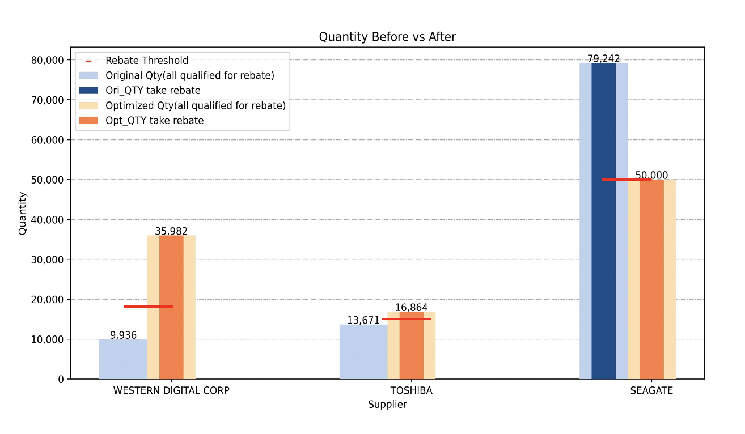
Prescriptive Analysis Examples
Examples
Cost Optimization
Production Planning & Scheduling
Reverse Logistics Optimization
Problem Understanding
Business Problem:
allocate quantities among suppliers to balance cost and risk
Business Problem:
sequence jobs in a factory to meet deadlines.
Business Problem:
handle returns and recycling efficiently
Objectives & Constraints
Objectives & Constraints
Objectives & Constraints
Objective: minimize the total spend vs risk tolerance
Constraints:
Quantity by PN > Demand for each PN
Rebate rule
Etc.
Objective: minimize total tardiness, or production costs
Constraints:
Machine availability
Job precedence
Shift schedules or maintenance windows
Objective: minimize return handling and transportation costs
Constraints:
Return centre capacities.
Refurbishing/processing time
Environmental compliance
Mathematical Modeling
Solver Coding
Results
Results
Results
Table:
Procurement plan with how much to buy at PN level
Chart:
Table:
Optimized job sequences
Expected production completion timeline
Chart:
Table:
Optimal routing for returns
Cost-efficient recovery network design.
Chart:
Result Interpretation

Slide 12
GenAI & Foundation Models & LLM
Generative AI (GenAI)
What it is: A broad category of AI that can generate new content such as text, code, images, music, or video.
Key trait: Instead of just analyzing or classifying data, it creates something new.
Examples:
ChatGPT (text)
DALL·E (images)
Watsonx Code Assistant (code)
Foundation Models
What it is: Backbone of GenAI. Large AI models trained on massive, diverse datasets in a self-supervised way.
Purpose: To serve as a general-purpose base that can be fine-tuned or used directly for various downstream tasks.
Modality: Can be text, vision, audio, or multimodal.
Examples:
GRANITE (IBM)
GPT (OpenAI)
GEMINI (Google)
LLaMA (Meta)
Claude, Flamingo (vision+text), MusicLM (Text to Audio)
Large Language Models (LLMs)
What it is: A subset of foundation models focused on natural language.
Specialty: Trained to understand and generate human-like text.
Examples:
Granite-3.1-8B
Granite-3.2-8B
Llama-3.1-70B
Granite-34B-Code
Generative AI
Foundation Models
Large
Language Models
(LLMs)
Other Modalities
(e.g. image, audio, etc.)

Slide 13

GenAI and Data Analysis
Automated Data Analysis
GenAI Platform
Behind the Scenes
Structured Data
(structured, predetermined insights)
Foundation Models
Extract, Transform, Load Data
Prompt
Text
Document
Image
Video
Audio
IBM Models
Open Models
Descriptive Analysis
Partner Models
Etc.
Diagnostic Analysis
Predictive Analysis
Responsible
AI & Safety
Prescriptive Analysis
Visualizations / Dashboards (AI Chart)
RAG
(optional)
Response
Citation Check
Scripted AI
Note:
RAG stands for Retrieval-Augmented Generation.
What It Is:
RAG is an AI technique that combines retrieval (search) and generation (LLM) to produce more accurate, grounded responses.
How It Works (Simplified):
Retrieve: Search a knowledge base (documents, database, etc.) for relevant context based on the user's question.
Augment: Feed the retrieved information into the prompt.
Generate: The LLM uses this context to generate a high-quality, informed answer.
Predefined Data Analysis
Quality Analysis API
iPSA API
Etc.

